Slide 1
RADAR ON ROADS.
PIP2001 Capstone Project
Review-0
Batch Number: CCS-G28
Roll Number | Name of Student
20211CCS0017 | M Sonali
20211CCS0026 | Bhavana MM
20211CCS0034 | Jakku Nishithaa
20211CCS0153 | Hiranmayi R
Under the Supervision of,
Dr. Nagaraj S R
Professor / Associate Professor / Assistant Professor
School of Computer Science and Engineering
Presidency University
Name of the Program: Computer Science and Engineering Spl. Cyber Security.
Name of the HoD: Dr. Anandaraj S P
Name of the Program Project Coordinator: Dr. Sharmasth Vali Y
Name of the School Project Coordinators: Dr. Sampath A K / Dr. Abdul Khadar A / Mr. Md Ziaur Rahman

Slide 2
Content
Problem Statement
Analysis of Problem Statement
Timeline of the Project
References

Slide 3
Problem Statement Number: PSCS42
Organization: MindTree
Category (Hardware / Software / Both) : Hardware
Problem Description: There is a significant pile-up of vehicles at toll booths, especially during weekends, across many cities. Despite the introduction of FASTag RFID stickers by NHAI, the system has not fully addressed the issue. In many locations, the FASTag system is either non-functional or only partially operational. Vehicles need to slow down for sensors to detect the sticker and deduct the toll fare, leading to inefficiencies. This project proposes a system similar to or better than those used in Dubai to improve the toll collection process.
Difficulty Level: Complex

Slide 4
Analysis of Problem Statement
Technology Stack Components:
GPS Technology:
Utilizes the NEO-6M GPS module to track real-time vehicle location and calculate distance traveled.
GSM Communication:
SIM800C GSM module for transmitting toll data, entry/exit notifications, and real-time fare updates to a central server.
Display System:
JHD 204A LCD Display (20x4) for showing real-time GPS coordinates, distance traveled, and toll fare to the driver.
Audio Notifications:
Speaker with PAM8403 amplifier module for providing audible alerts about toll entry, fare updates every 10 km, and exit notifications.
IoT Integration:
For real-time data transfer to a remote toll system and ensuring seamless toll calculation and payment.
Embedded Systems:
ESP32 microcontroller for managing GPS and GSM modules, handling fare calculation, and controlling the display and speaker.
Power System:
18650 batteries (5000mAh) with HX-4S-A20 board for powering the entire system independently.

Slide 5
Analysis of Problem Statement (contd...)
Software Requirements:
Software Overview:
Manages GPS tracking, toll calculation, and communication with the backend system.
Firmware for GPS and GSM Modules:
Handles GPS data collection and real-time location tracking using the NEO-6M GPS module, as well as sending toll data and fare updates via the SIM800C GSM module.
Fare Calculation Logic:
Implements algorithms for calculating tolls based on the distance traveled, updating every 10 km, and communicating the fare to the display and speaker.
Data Management Software:
Integrates with the backend system for recording vehicle entry/exit, updating toll charges, and sending notifications to the central server.
IoT Communication Protocols:
Ensures real-time communication between the ESP32, GPS, GSM modules, and the backend toll system for data transmission and notifications.

Slide 6
Analysis of Problem Statement (contd...)
Hardware Requirements:
Hardware Components:
GPS Module:
NEO-6M GPS module for real-time vehicle tracking and distance calculation.
GSM Module:
SIM800C GSM module for communication with the central server, sending toll data, and receiving fare updates.
LCD Display:
JHD 204A (20x4) LCD for displaying GPS coordinates, distance traveled, and fare information in real-time.
Speaker and Amplifier:
PAM8403 amplifier module paired with a speaker to provide audible notifications, such as fare updates and toll entry/exit alerts.
Microcontroller:
ESP32 for managing GPS, GSM, LCD, and speaker, handling fare calculations, and enabling wireless communication with IoT systems.
Battery System:
18650 Li-ion batteries with HX-4S-A20 board for powering the system independently from external power sources.

Slide 7
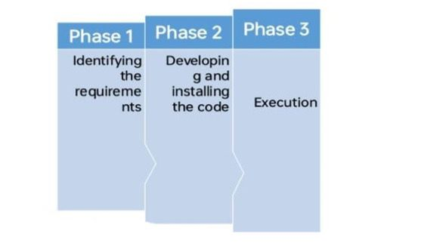
Timeline of the Project (Gantt Chart)

Slide 8
References (IEEE Paper format)
https://www.indeed.com/career-advice/career-development/how-to-cite-a-research-paper

Slide 9


